Slide 1
Column Select Service Algorithm
Zudy
September 10, 2014

Slide 2
All columns are assigned a width, a priority, and a display order, and an indicator if they can be clipped:
Width
  The width of the column in characters (ie. A column displaying phone numbers formatted like: “(613)-555-1212” is 14 characters wide, “John Smith”).
  Columns can have a width that is smaller than the data they contain, in which case they are truncated with ellipsis: “John Smith” becomes “John S…”
Priority
  Priority dictates the priority of columns being removed from the table as it gets smaller. Priority 1 columns are never removed. Higher priority columns are removed before lower priority columns.
Display order
  Display order is a unique ordering of the columns as they should be displayed, left to right.
canBeClipped:
  Columns also contain a property canBeClipped – a value that indicates we are willing to display a (possibly) much smaller amount of the column than desired in the interest of not leaving whitespace in the table.
Additional inputs:
availableSpace for the table in characters.
paddingAdjustment – a number that we add to columnWidth to account for table padding.
squeezeThreshold – if our table has at least this much empty space, even if a column doesn’t fit, if column.canBeClipped is true, we will try to fit it in.

Slide 3
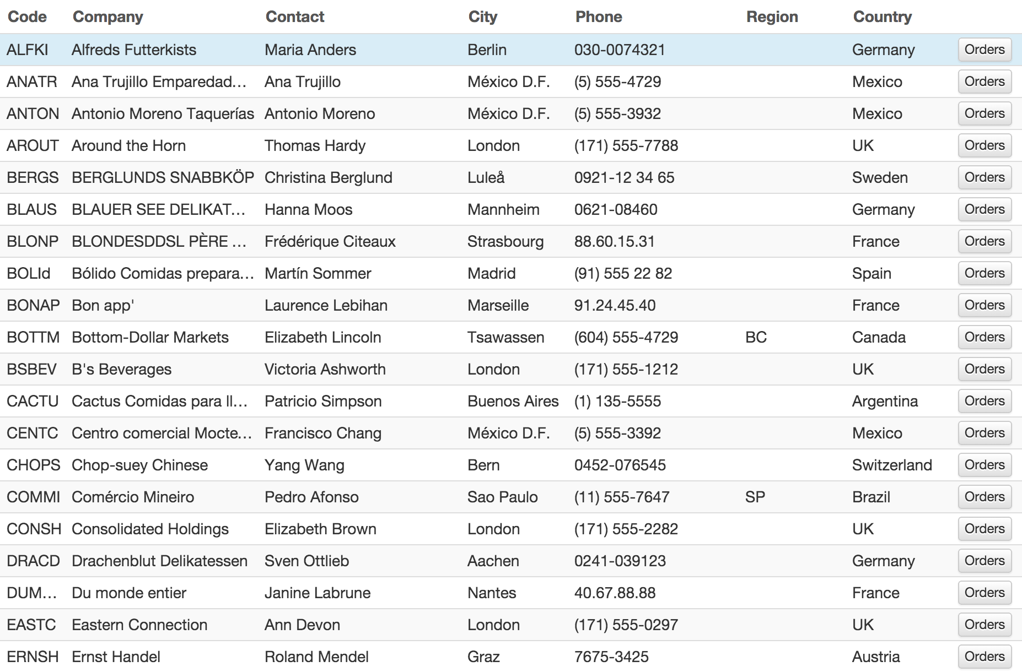
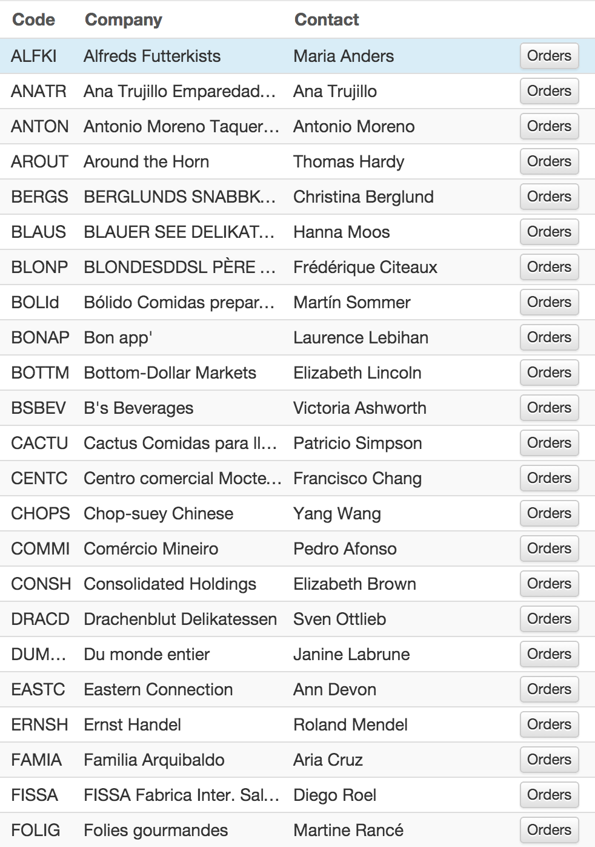
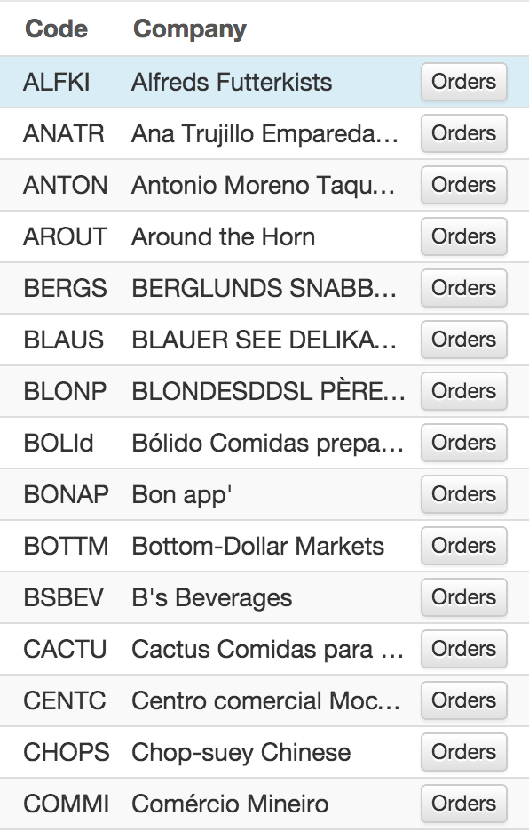
Different devices have different amounts physical display for rendering tables.
These screens show the output of the algorithm run with different values for availableSpace.

Slide 4
Inputs:
List or array of columns and their associated properties.
availableSpace
paddingAdjustment
squeezeThreshold
Outputs:
List or array of columns to display, in display order, and their associated percentage of space to take up in the table.
Column Select Service Algorithm
As described on following slides

Slide 5
// Sort columns by priorityOrder (lowest first). (See Note 2)
var columnsSortedByPriority = sortColumnsByPriority(columns);
// We track how much space we allocate since we might not use
// the entire space available:
var charactersAllocated = 0;
// We loop through the list of columns in priority order.
// column.width is adjusted by a constant value to account for
// padding in our table:
foreach (var column in columnsSortedByPriority) {
  column.width += paddingAdjustment;
  // (See Note 3)
  if (availableSpace – column.width < 0 && availableSpace > squeezeThreshold) {
  // Not enough space – but perhaps we can squeeze it in
  if (column.canBeClipped) {
  column.width = availableSpace;
  }
  }
  availableSpace -= column.width
  if (availableSpace > 0 || column.priority == 1 || visibleColumns == 0) {
  // Add the column to our visible list
  charactersAllocated += column.width;
  column.visible = true;
  } else {
  coloumn.visible = false;
  }
}

Slide 6
// We loop through visible columns to calculate what percent of the
// table they should fill:
foreach (var column in columnsSortedByPriority) {
if (column.visible) {
column.percentSpace = column.width / charactersAllocated;
}
}
// We build our list of visible columns in display order – loop
// through columns in display order list, if they are not visible,
// they are removed from the list.
// (See Note 2)
var visibleColumns = sortColumnsByDisplayOrderVisible(columnsSortedByPrioriy)
// Output of the algorithm is the list of visible columns to display, in
// order, and their percentWidth.
return visibleColumns;

Slide 7
Notes
Columns could be in a list or an array.
Sorting of columns could be done using a variety of techniques and algorithms.
Squeezing in one last column could be a variation of a more basic algorith that doesn’t include squeezing columns in.

